Slide 1


Smart School & NFC

Slide 2

Introduction

Slide 3


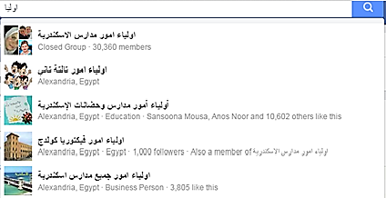
Needs
parents need
Introduction
Web Application
NFC
Mobile Application
Future Feature

Slide 4
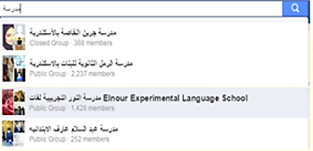
Needs
Teachers need
Introduction
Web Application
NFC
Mobile Application
Future Feature

Slide 5
Analysis
Public
Schools
Private Schools
Dynamic
website
Introduction
Web Application
NFC
Mobile Application
Future Feature

Slide 6
Analysis
Easy system for school
Contact between school and parents
Introduction
Web Application
NFC
Mobile Application
Future Feature

Slide 7
Analysis
Web Site to contact with parents:
About School.
Support Materials for Subjects.
Useful entertainment.
Profile for each Student
Easy System for school :
Database system for Students and Teachers
Library.
Introduction
Web Application
NFC
Mobile Application
Future Feature

Slide 8
Value
Mobile Application For Teachers to
contact with parent
For any new notification like Exams or Attendance or requirements.
Connected with System and Web Site
NFC
Introduction
Web Application
NFC
Mobile Application
Future Feature

Slide 9


Tasks
General DB.
Dynamic web Site connect with management system .
Data Entry and management :
Teacher .
Library .
Manger.
Profile for each student.
NFC.
Mobile application Connection with MYSQL DB (web services).
Student Entertainment and Material:
Displaying videos.
Drawing.
Display Images.
Games.
Notifications for parent.
Chat between parent and teacher.
Introduction
Web Application
NFC
Mobile Application
Future Feature

Slide 10
Swat Analysis
S | W | O | T
1-ITI. 2-we have a client. 3-Experience in Teaching. 4-Experience in NFC Technology. 5- Project for free. 6- general database | 1-time | 1-There is a big Need for this project. | 1- ignorant Parents.
Introduction
Web Application
NFC
Mobile Application
Future Feature

Slide 11
Vission
To have a leading Role in the school Systems.
Mission
make the community better for free.
Introduction
Web Application
NFC
Mobile Application
Future Feature

Slide 12
Web Application

Slide 13
Web Application
Front End
Back End
Bootstrap
JQuery
MySQL
Symfony Framework
Introduction
Web Application
NFC
Mobile Application
Future Feature

Slide 14
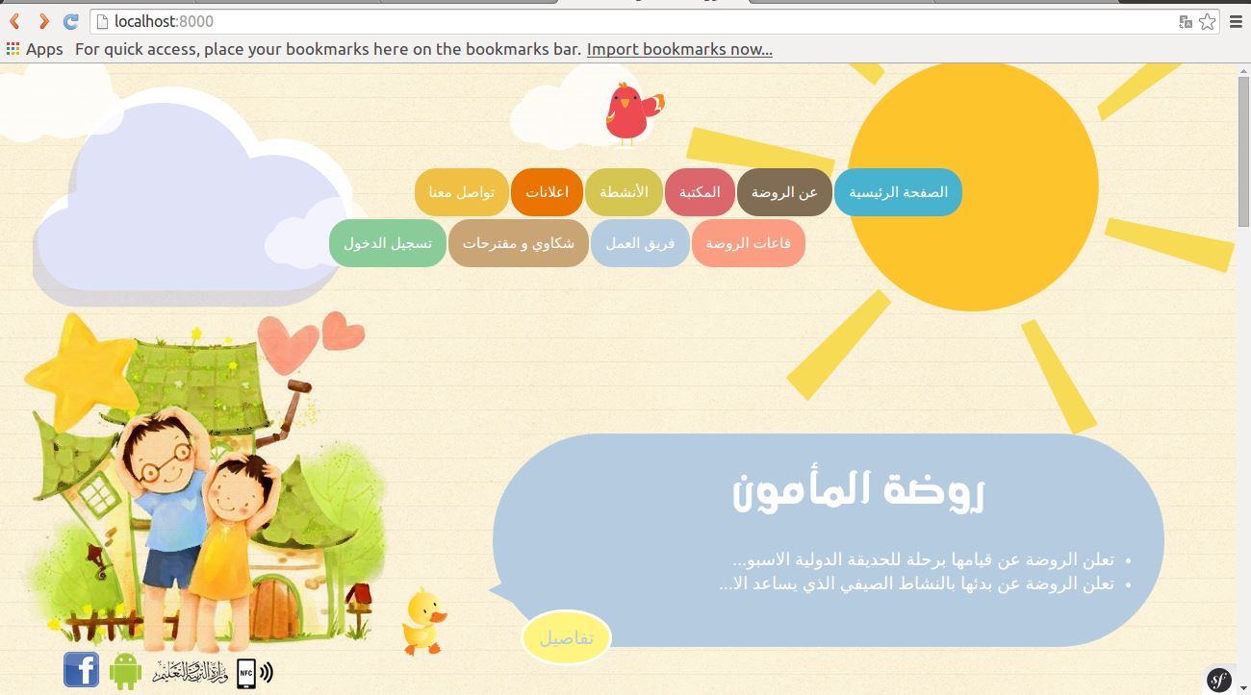

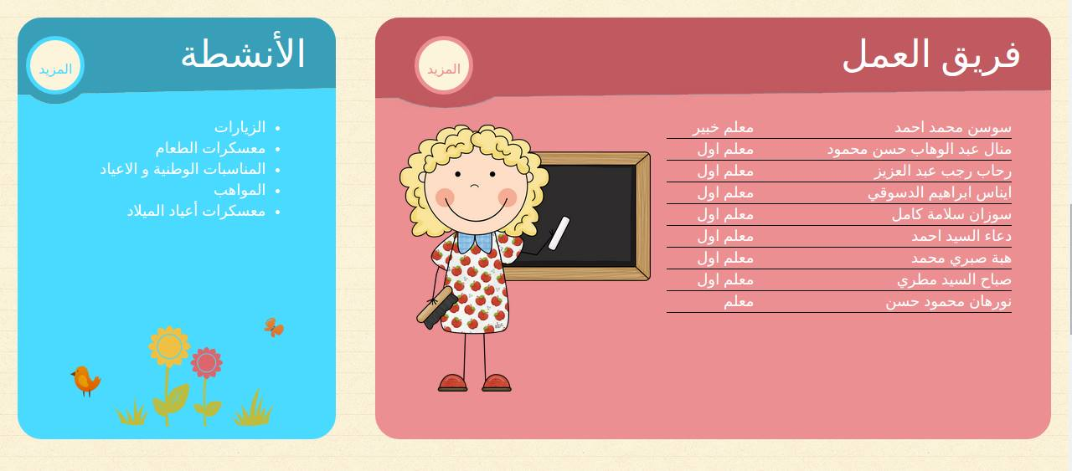

Front End
Introduction
Web Application
NFC
Mobile Application
Future Feature

Slide 15
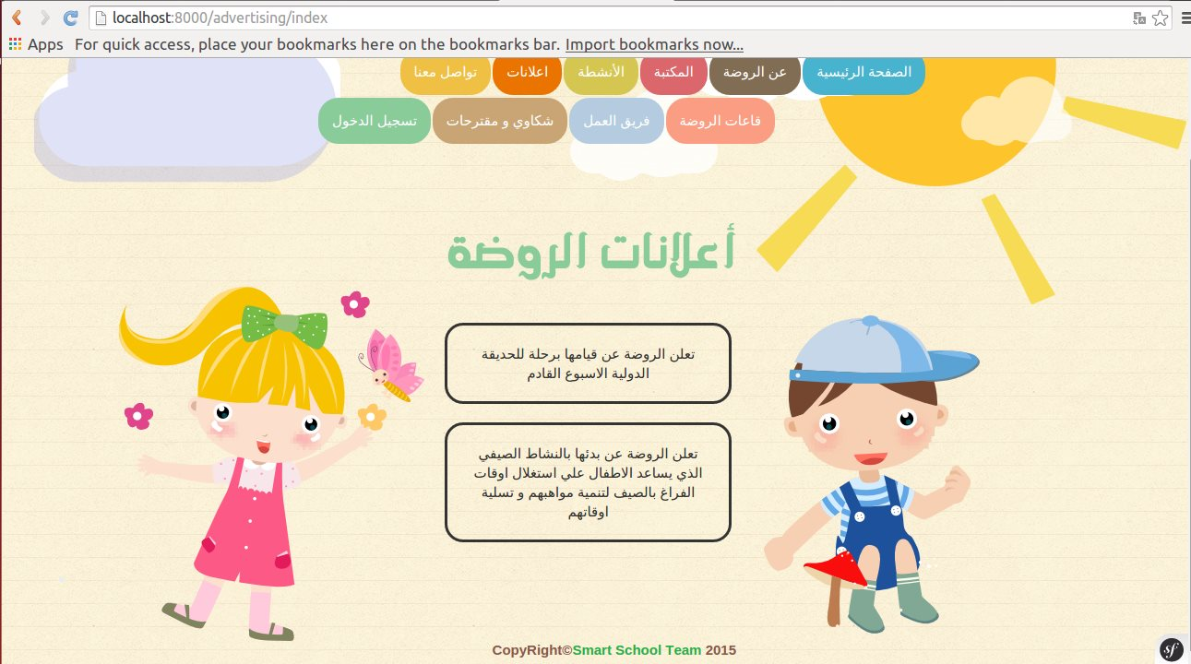
Front End
Introduction
Web Application
NFC
Mobile Application
Future Feature

Slide 16
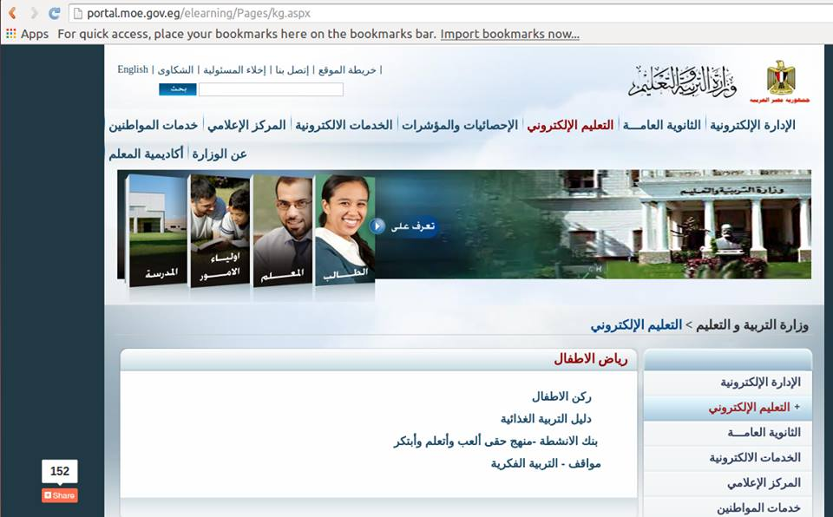


Front End
Introduction
Web Application
NFC
Mobile Application
Future Feature

Slide 17


Front End
Introduction
Web Application
NFC
Mobile Application
Future Feature

Slide 18
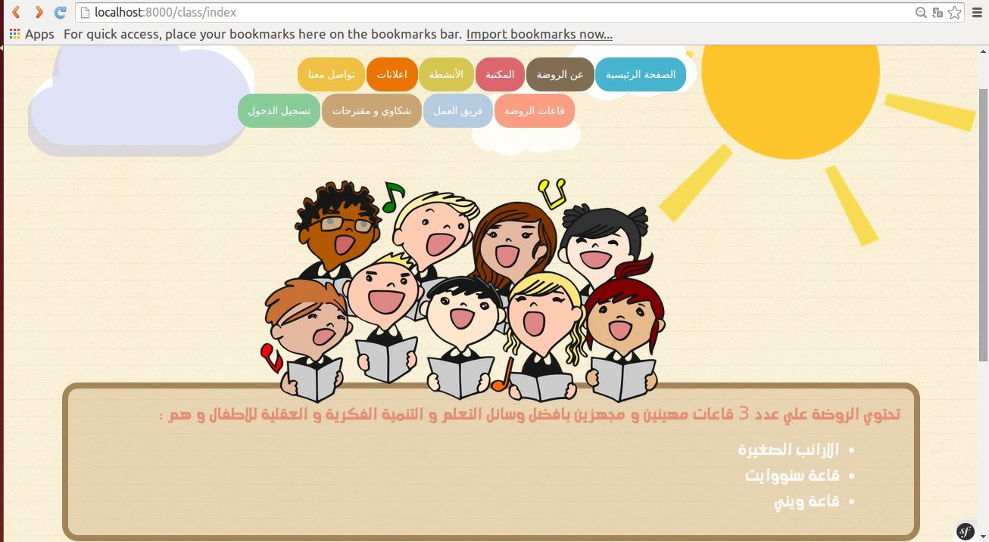
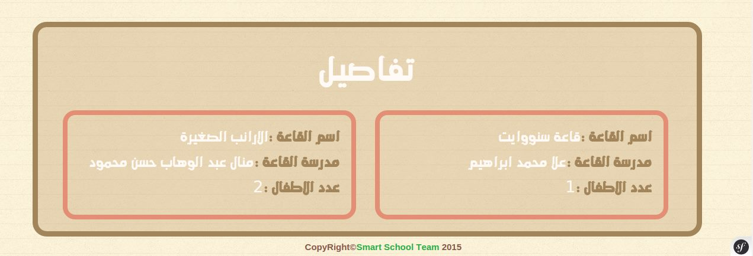
Front End
Introduction
Web Application
NFC
Mobile Application
Future Feature

Slide 19

Front End
Introduction
Web Application
NFC
Mobile Application
Future Feature

Slide 20
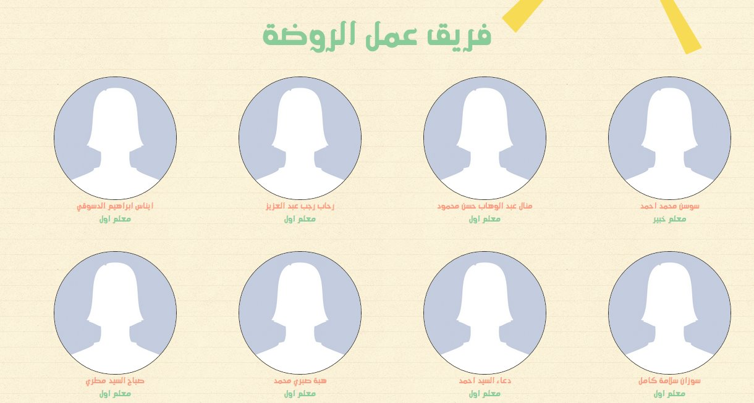
Front End
Introduction
Web Application
NFC
Mobile Application
Future Feature

Slide 21
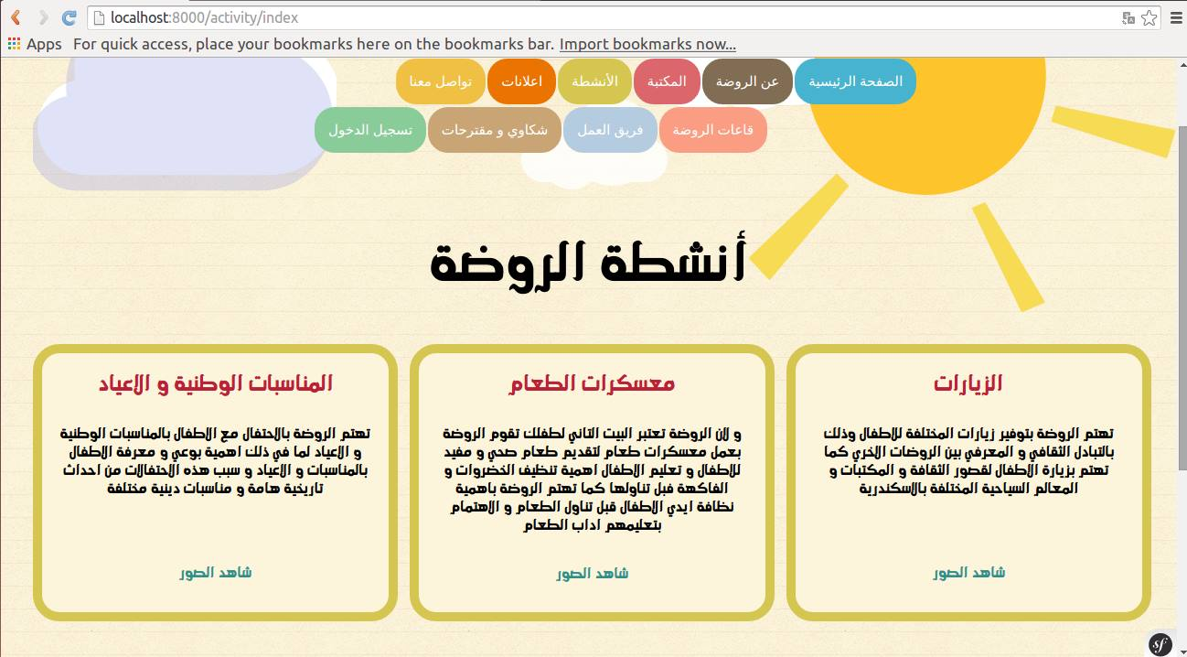
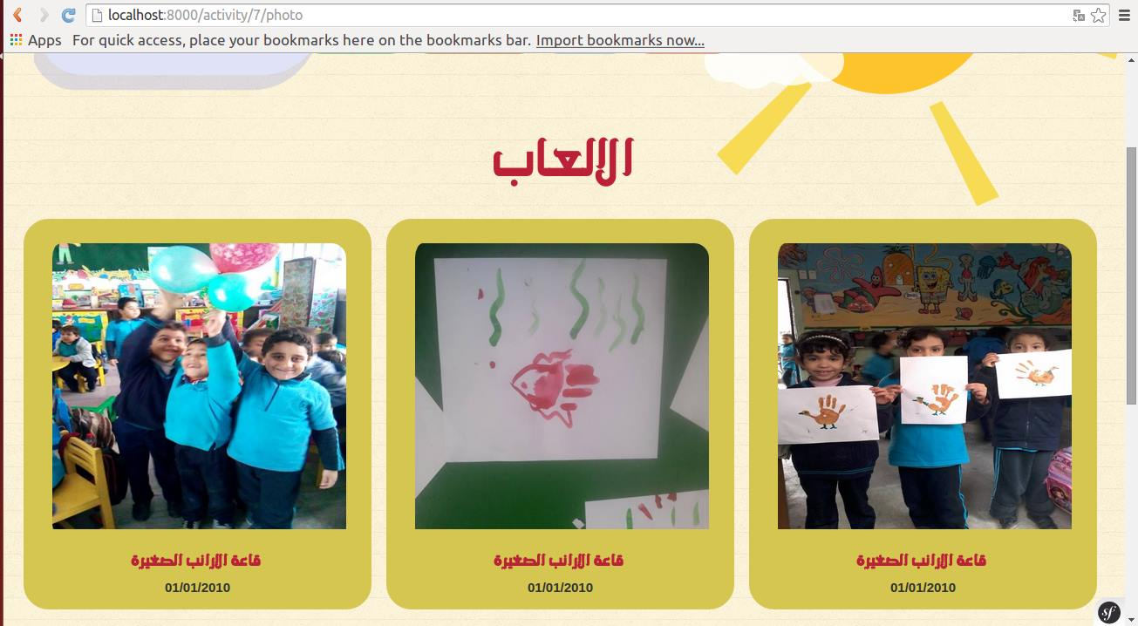
Front End
Introduction
Web Application
NFC
Mobile Application
Future Feature

Slide 22
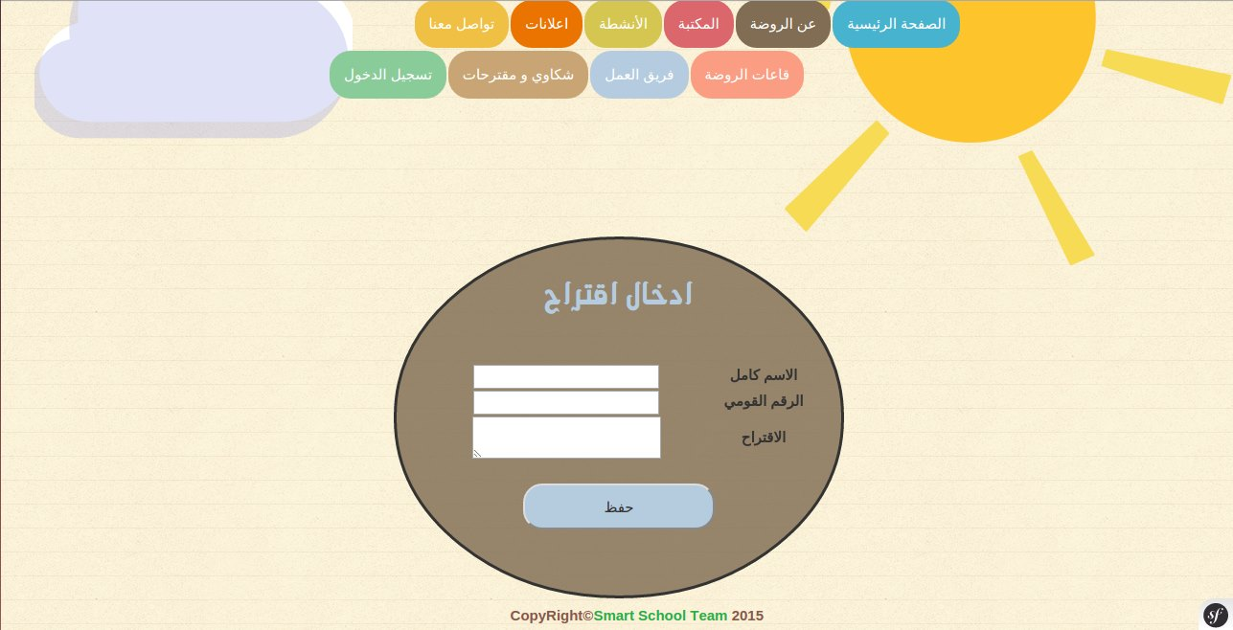
Front End
Introduction
Web Application
NFC
Mobile Application
Future Feature

Slide 23
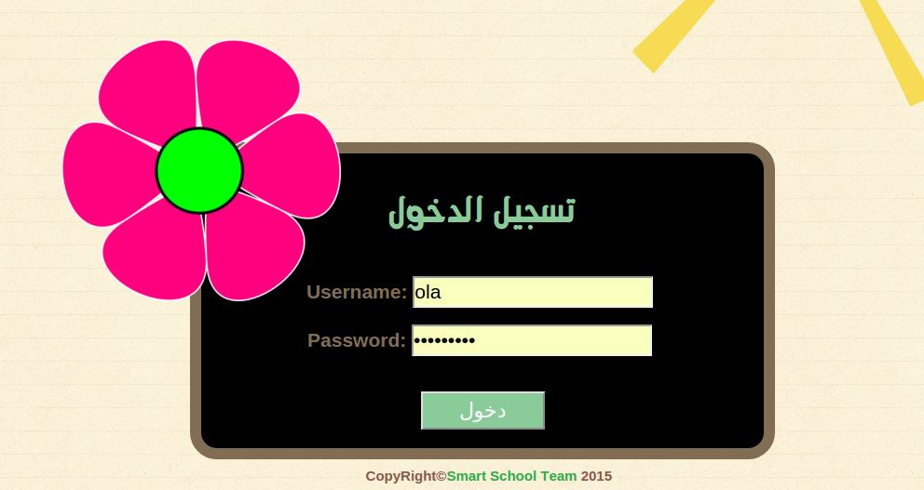


Front End
Introduction
Web Application
NFC
Mobile Application
Future Feature

Slide 24
Web Application
Front End
Back End
Bootstrap
JQuery
MySQL
Symfony Framework
Introduction
Web Application
NFC
Mobile Application
Future Feature

Slide 25
Back End
Login
- As a manger
- As a teacher
- As a librarian
- As a student
Introduction
Web Application
NFC
Mobile Application
Future Feature

Slide 26
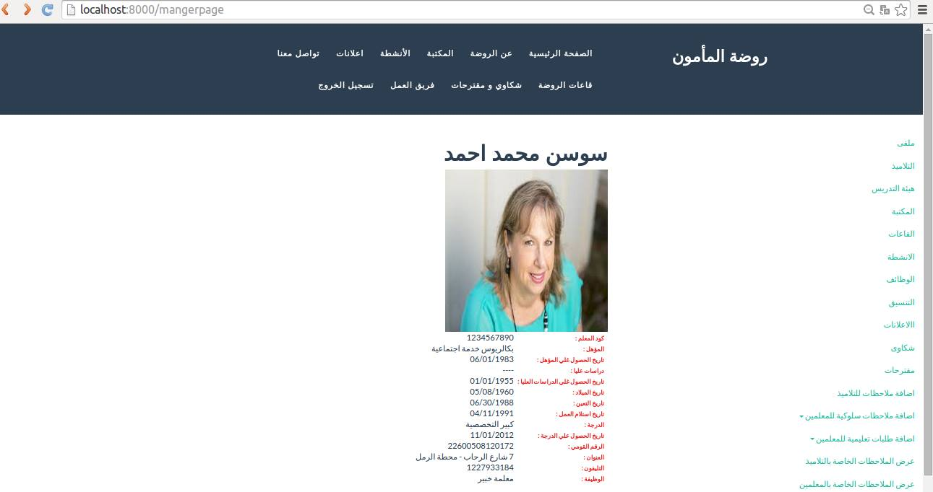
- As a manger
Introduction
Web Application
NFC
Mobile Application
Future Feature

Slide 27
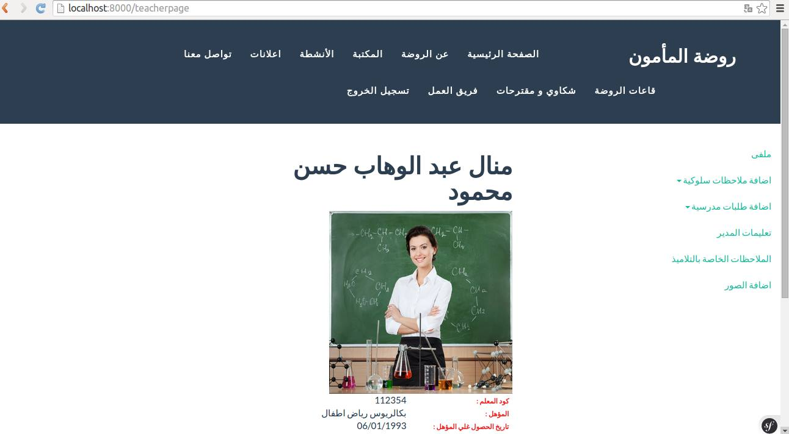
- As a teacher
Introduction
Web Application
NFC
Mobile Application
Future Feature

Slide 28
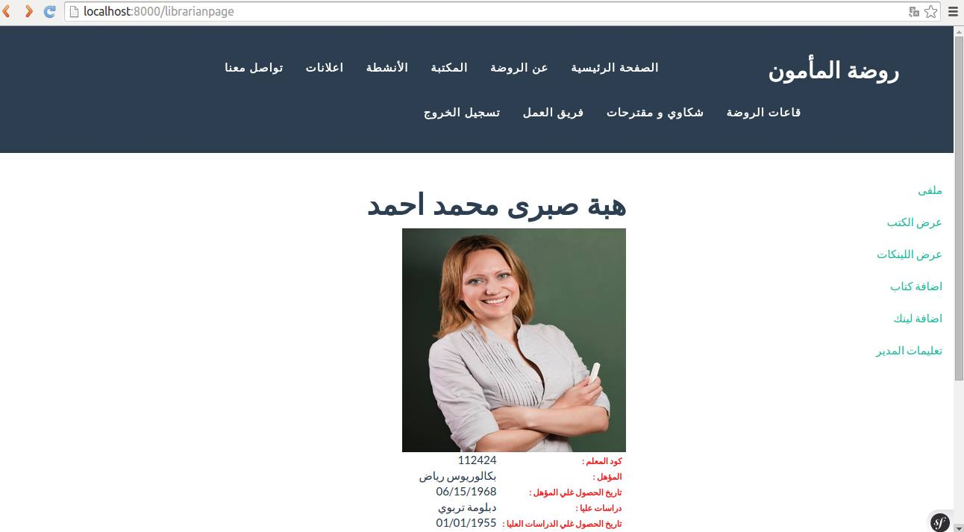
- As a librarian
Introduction
Web Application
NFC
Mobile Application
Future Feature

Slide 29
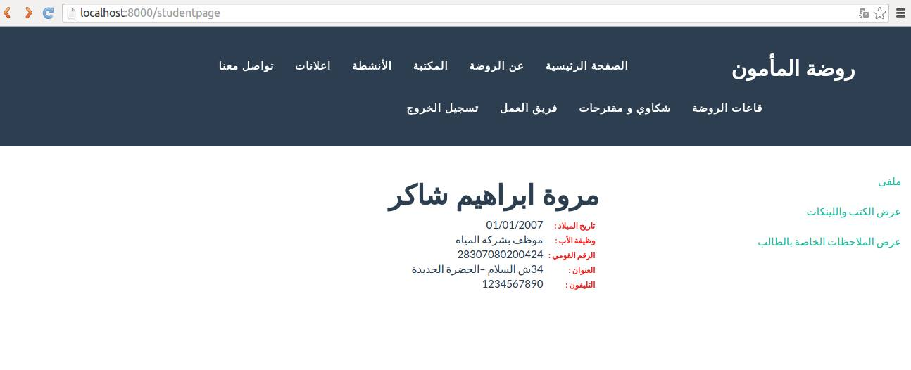
- As a student
Introduction
Web Application
NFC
Mobile Application
Future Feature

Slide 30
NFC

Slide 31

NFC
Near Field Communication
13.56 MHz
Introduction
Web Application
NFC
Mobile Application
Future Feature

Slide 32
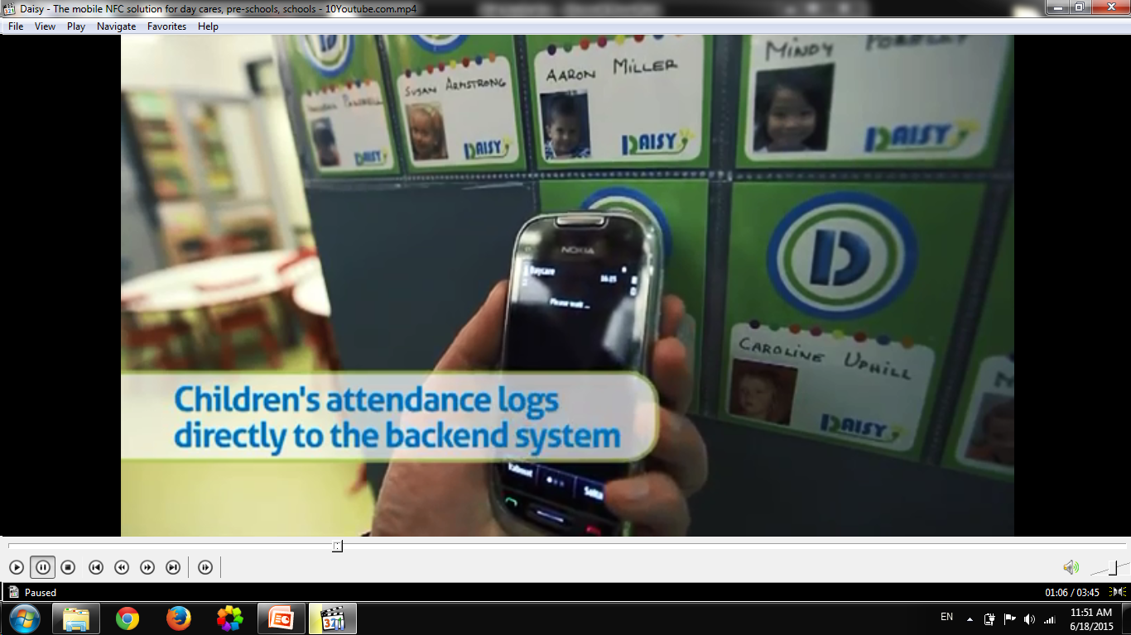


Introduction
Web Application
NFC
Mobile Application
Future Feature

Slide 33
Mobile Application
Back End
Front End
XML
Android
Java
MySQL
Introduction
Web Application
NFC
Mobile Application
Future Feature

Slide 34

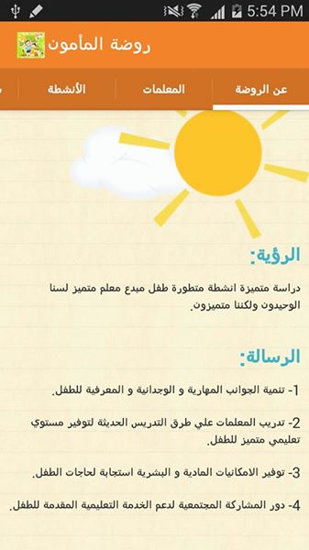
Mobile Application
Splash Screen
First tab
Introduction
Web Application
NFC
Mobile Application
Future Feature

Slide 35
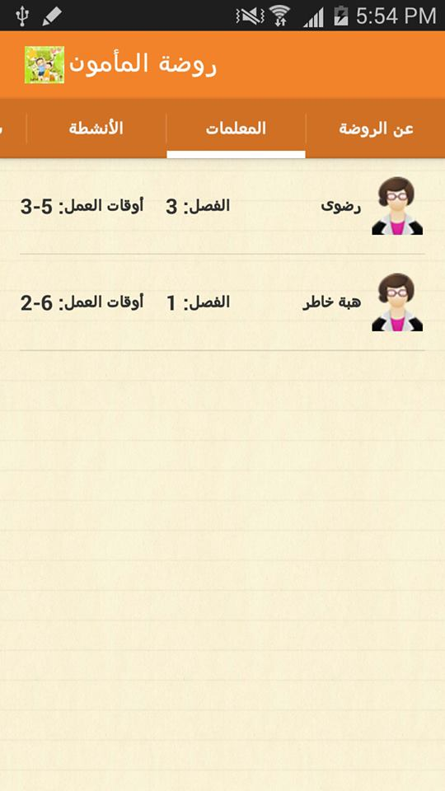
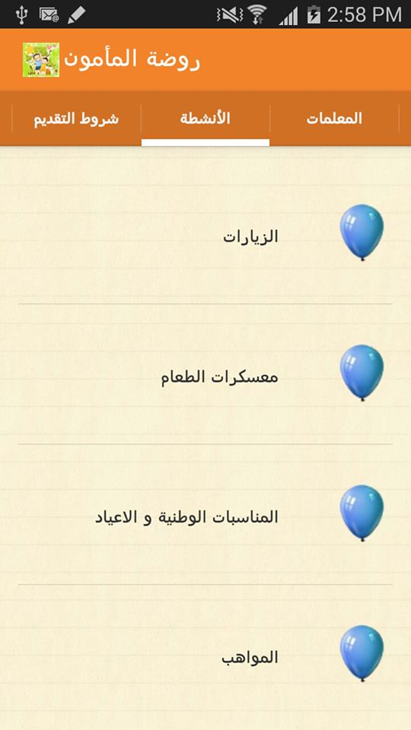
Mobile Application
Second Tab
Third Tab
Introduction
Web Application
NFC
Mobile Application
Future Feature

Slide 36

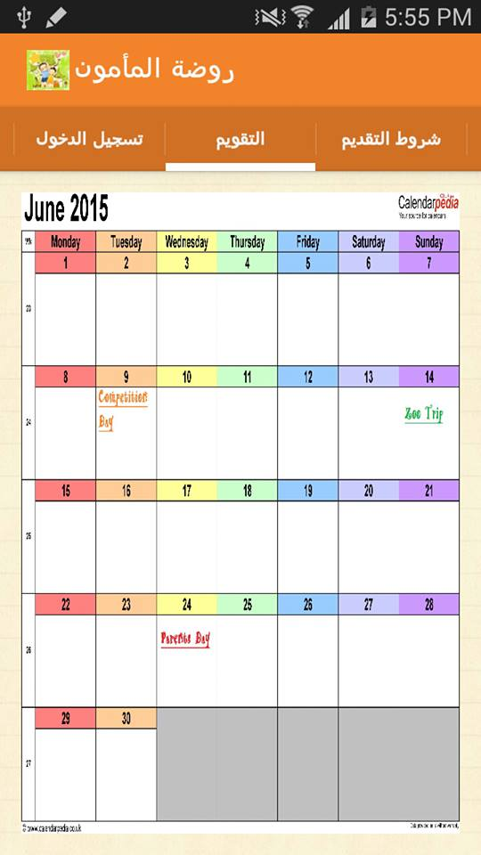
Mobile Application
Forth Tab
fifth Tab
Introduction
Web Application
NFC
Mobile Application
Future Feature

Slide 37
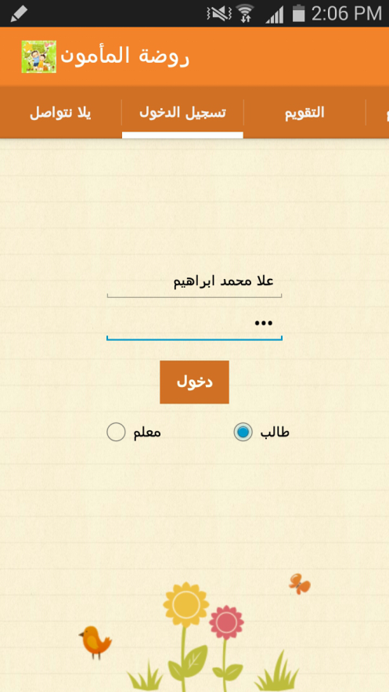
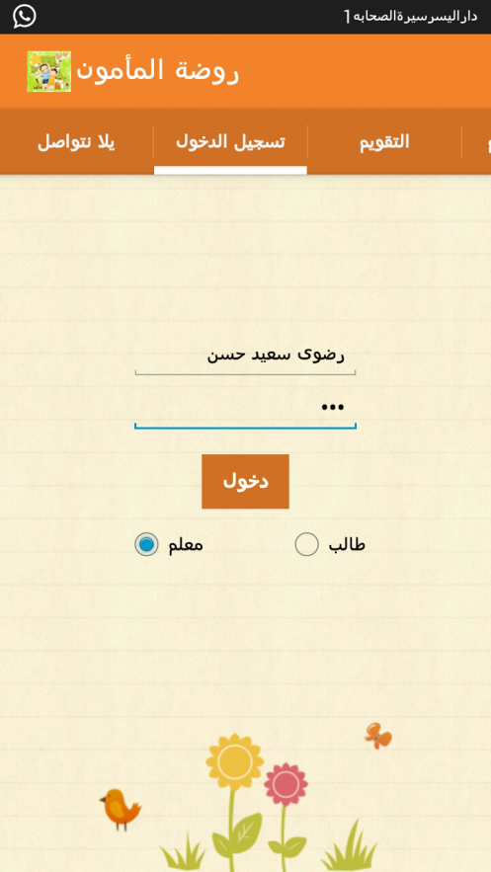
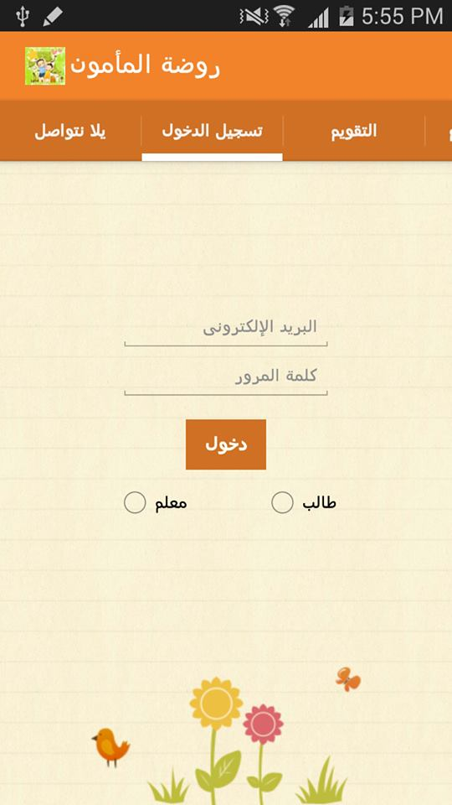
Mobile Application
Sixth Tab
Login as student
Login as teacher
Introduction
Web Application
NFC
Mobile Application
Future Feature

Slide 38
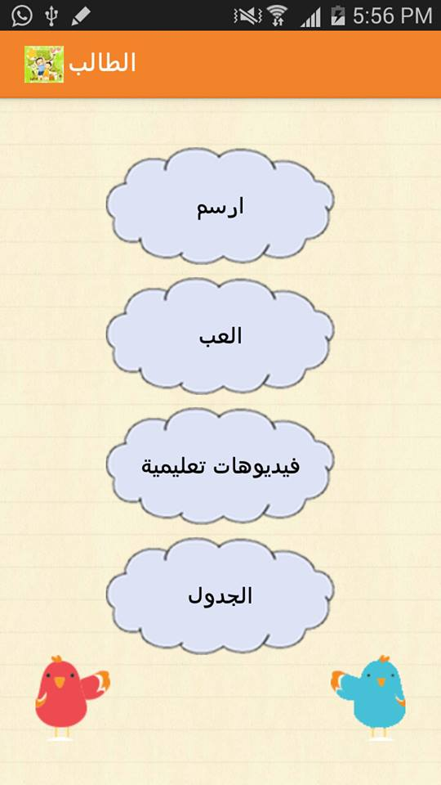
Mobile Application
Login As Student
Introduction
Web Application
NFC
Mobile Application
Future Feature

Slide 39


Mobile Application
1)Draw
Introduction
Web Application
NFC
Mobile Application
Future Feature

Slide 40
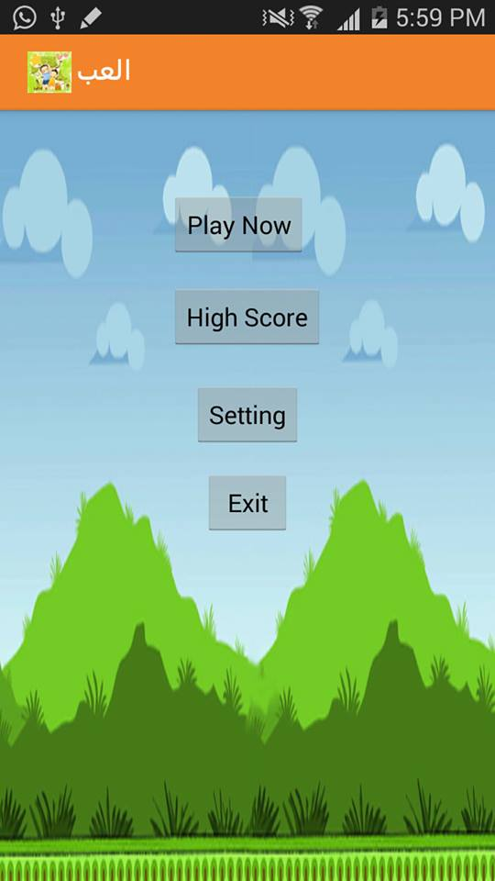
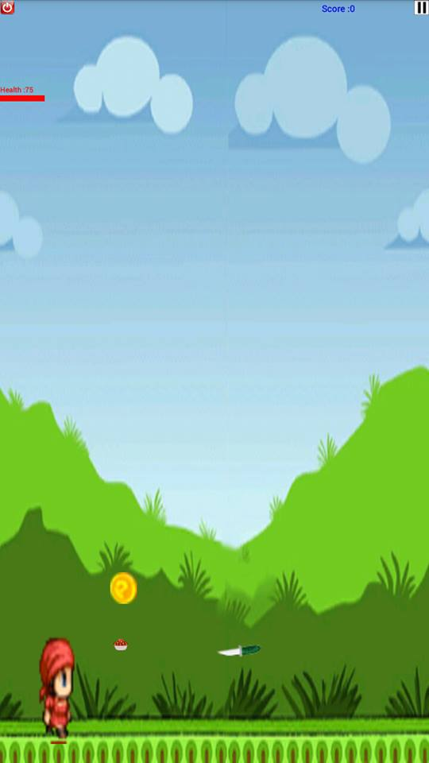
Mobile Application
2)Play
Introduction
Web Application
NFC
Mobile Application
Future Feature

Slide 41


Mobile Application
3) Educational video
a)
b)
Introduction
Web Application
NFC
Mobile Application
Future Feature

Slide 42

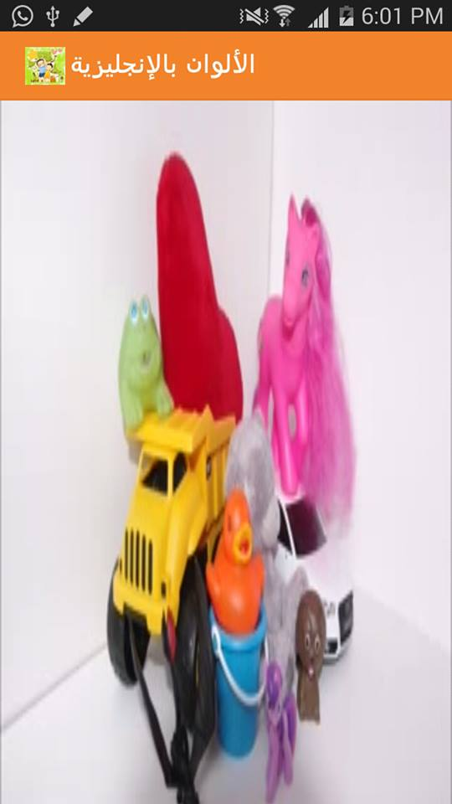
Mobile Application
3) Educational video
c)
d)
Introduction
Web Application
NFC
Mobile Application
Future Feature

Slide 43
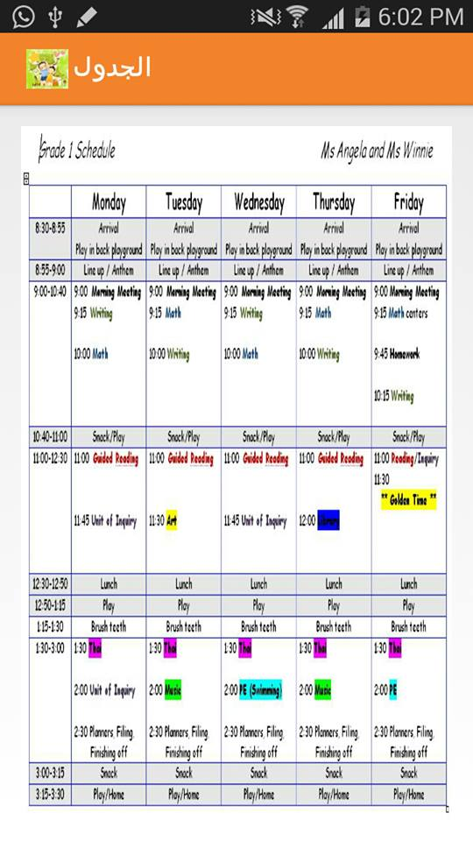
Mobile Application
4)Schedule
Introduction
Web Application
NFC
Mobile Application
Future Feature

Slide 44
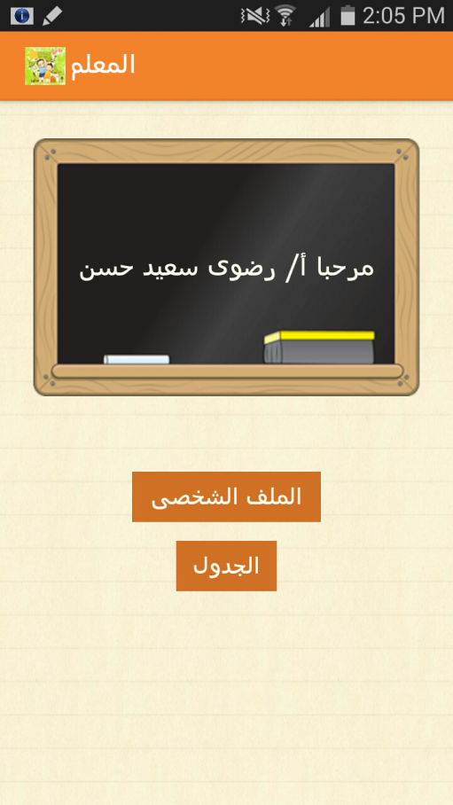
Mobile Application
Login As a Teacher
Introduction
Web Application
NFC
Mobile Application
Future Feature

Slide 45

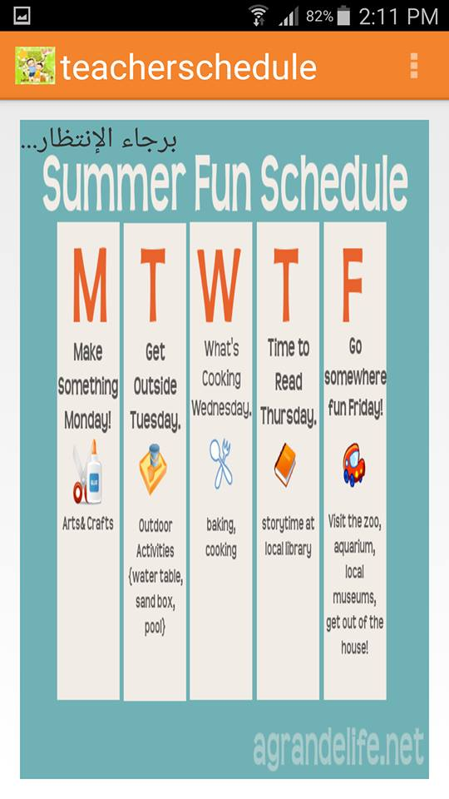
Mobile Application
1) Teacher Profile
2) Teacher Schedule
Introduction
Web Application
NFC
Mobile Application
Future Feature

Slide 46
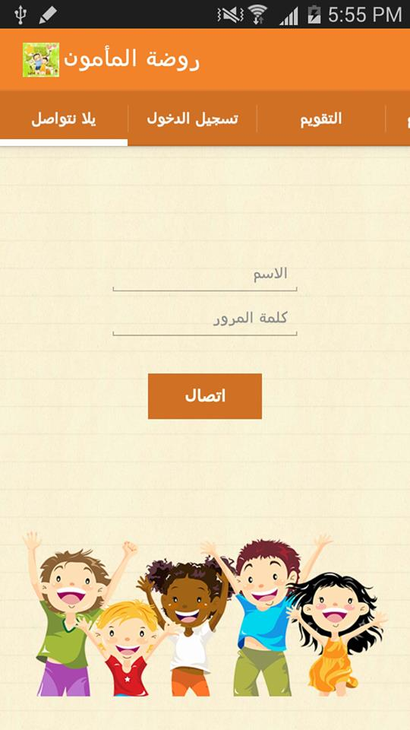
Mobile Application
Seventh Tab
Introduction
Web Application
NFC
Mobile Application
Future Feature

Slide 47
Web Services
Web services are client and server applications that communicate over the World Wide Web’s Hypertext Transfer Protocol (HTTP).
Web services provide a standard means of interoperating between software applications running on a variety of platforms and frameworks.
Introduction
Web Application
NFC
Mobile Application
Future Feature

Slide 48


Request from client to server
Web
Services
Response from server to client
Android Client
Database Server
Introduction
Web Application
NFC
Mobile Application
Future Feature

